Slide 1






Cathay Pacific IBM WebSphere Message Upgrade
Doc Ref:
A RGP Proposal for International
30-Sep-2016

Slide 2
TABLE OF CONTENTS
SECTION | PAGE
RGP Overview | 3
Our Capabilities in Message Queue Implementations | 8
Our Understanding of Cathay Pacific’s Objectives | 10
Project Approach | 20
Proposed Team Structure | 28
Project Schedule | 30
Conclusions | 33
Q & A | 37
Appendix A – Requested Items for Impact Analysis | 39
Appendix B – RGP’s Project & Change Management Framework | 41

Slide 3
RGP Overview

Slide 4

RGP OVERVIEW
WHO WE ARE |  | GLOBAL REACH
WHAT WE DELIVER |  | OUR CLIENTS
A leading innovator in professional services:
Founded in 1996
Big Four heritage
NASDAQ listed (RECN)
13
$567MM | REVENUE IN FY 2014
3,100 | PROFESSIONALS WORLDWIDE
70+ | OFFICES GLOBALLY
100% | TOP 50 CLIENTS RETAINED YEAR OVER YEAR
RECOGNIZED | AS ONE OF THE 100 MOST TRUSTWORTHY COMPANIES BY FORBES.COM
47
OFFICES SUPPORTING EUROPE
12
OFFICES SUPPORTING THE AMERICAS
OFFICES SUPPORTING ASIA PACIFIC
People. Experienced Consultants with industry, commercial, functional and leadership experience; with an emphasis on execution and optimization.
Approach. Tailored and collaborative, resulting in knowledge transfer and sustained transformation without long-term reliance on external consultants.
Support. Project oversight and subject matter expertise provided by local Client Service Teams and global Practice Leaders on an unbilled basis.
Scale. Financial stability, global reach, cross-functional/enterprise-wide capabilities.
Cost. Reasonable hourly rates and variable cost engagement model. Administrative fees are never billed.
Value. A value proposition that far outdistances any competing offer.
85% | OF THE FORTUNE 1000 COMMERCIAL BANKS
75% | OF THE FORTUNE 1000 FINANCIAL DATA SERVICES COMPANIES
4 of 5 Top | OF THE FORTUNE 500 SECURITIES FIRMS
87% | OF THE FORTUNE 100
“We are a leading innovator in the consulting space providing a high quality, cost effective alternative to traditional consulting firms.”
Intellectual capital on demand.
Peter Drucker on RGP’s Business Model in the Harvard Business Review
OUR VAULES TALENT  INTEGRITY  ENTHUSIASM  LOYALTY

Slide 5
ENTERPRISE-WIDE CAPABILITIES
Enterprise-Wide Initiatives
Business process re-engineering
Transformation programs
Mergers & acquisitions
Outsource transition
Shared services
Operational excellence
policyIQ® software
Pavisse™ software
Regulatory compliance
Sarbanes-Oxley
Program Management ▪ Project Management ▪ Change Management
Finance & Accounting
Financial reporting
Restatements
General accounting
Accounting standards
Financial planning & analysis
Finance transformation
Shared services
M&A integration
Carve-out financials
Controls remediation
Process optimization
Governance, Risk & Compliance
Internal & IT audit co-sourcing
Sarbanes-Oxley compliance
Performance & mock audits
Contract / counter party audits
Compliance audits
Corporate governance
Enterprise risk management
Fraud / forensic audits
Information Management
Business analysis & integration
Process improvement
Implementation
Stabilization & optimization
Quality Assurance
Data management
Report strategy & development
IT governance & security
Outsourcing strategy
IT strategic planning
Human Capital
Organizational development / design
Change management
HR transformations
Training & communications
Compensation & benefits redesign
HR system initiatives
HR restructuring
Talent management
Succession planning
HR compliance
Procurement & Supply Chain
Supply chain assessment
Strategic sourcing
Conflict Minerals compliance
Commodity management
Capital procurement
Inventory rationalization
Contract management
Logistics & warehousing
Vendor audit
Legal & Regulatory
Commercial transactions
Mergers, acquisitions & restructurings
Regulatory compliance
SEC filings & corporate governance
IP agreements
Litigation management & investigations
Employment/ Employee benefits
Legal operations optimization
Our wide array of expertise allows us to support both your functional and enterprise-wide initiatives.

Slide 6
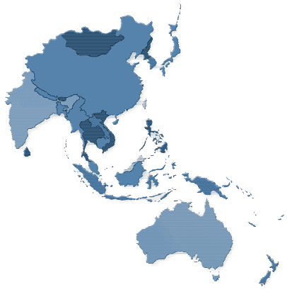


APAC SNAPSHOT
APAC Snapshot
500 projects; multiple pan-Asia
12 offices
300 professionals
Clients in 22 countries
Countries Served:
Australia
Cambodia
China
India
Indonesia
Japan
Korea
Malaysia
Industries Served:
Automotive
Energy
Financial Services
Hospitality/Gaming
Mongolia
Japan
South Korea
Resources Global Office
Additional locations where Resources Global has delivered projects
Mongolia
Nepal
New Zealand
Singapore
Sri Lanka
Taiwan
Thailand
The Philippines
Vietnam
Nepal
China
India
Taiwan
Thailand
The Philippines
Vietnam
Malaysia
Cambodia
Sri Lanka
Singapore
Indonesia
Australia
Insurance
Manufacturing
Mining
Pharmaceutical
Technology
Real Estate
Retail/FMCG
Safety
Telecommunications
New Zealand

Slide 7





















RGP HONG KONG
Established since 2000
Has 70+ Consultants average 18 years of experience with Big4 / MNC background
Professional expertise in:
Finance & Accounting
Information Management
Risk & Compliance
Clients we work with in Hong Kong

Slide 8
Our Capabilities in Message Queue Implementations

Slide 9

CASE STUDY
Engagement Example
CLIENT | China Construction Bank (Asia) - CCBA
INTIATIVE | New MQ Server Setup & Old Server Performance Tuning
CHALLENGE | CCBA has implemented a complicated routing business logic into the message broker. The performance is difficult to spot in different channels.
HOW WE HELPED | Setup measurement points in the critical queues of the message flow and closely monitor the life time of the messages in each queue to calculate the time consumption in different stages of the message flow.

Slide 10
Our Understanding of Cathay Pacific’s Objectives

Slide 11
OUR UNDERSTANDING
Cathay Pacific has implemented IBM WebSphere Message Queue and relevant communication client applications for years. Due to the end of support of MQ version 6/7, the company has planned to kick start the MQ upgrade project from version 6 to version 8.
CX MQ Usage Information:
Existing MQ WebSphere version 6
Target MQ WebSphere version 8
4 MQ Managers
Approximately 510 to 520 queues
Around 100 application endpoints
MQ Server running on IBM Power 6 AIX V5R4
MQ Client application technologies includes but no limited to z/OS, JMS/Java, C and AS/400

Slide 12
IBM WEBSPHERE MESSAGE QUEUE 8
Our Approach I - Changes Analysis
Increase queue message length to support larger messages
Introduce channel authentication to control the MQ server users' access to queues
Use multiple transmission queues to distribute the traffic
Increase the log file size for MQ logging
Adjust CLNTCONN channels load balancing weight according to the actual network
Justify the connection limit on connection limit
*Determine whether application team or middleware team need to apply new features in the new MQ version

Slide 13
IBM WEBSPHERE MESSAGE QUEUE 8
Our Approach II - Compatibility Analysis - MQSeries Analysis
Transmission queues can be defined for different traffic separately, and the default transmission queue is not more named SYSTEM.CLUSTER.TRANSMIT.QUEUE
The mechanism of Publish/Subscribe is changed
SSL and TLS would applied an Authority Information Access by default
Self-developed shell script need to scan the changed or obsolete MQSC commands.
In-used SupportPac upgrade

Slide 14
IBM WEBSPHERE MESSAGE QUEUE 8
Our Approach III - Compatibility Analysis - Endpoint Applications
JMS Reason Code Changes, some client application may decode the obsolete reason code to return message or exception
Some JMS objects are no longer serializable, application team need to investigate the program flow and hierarchy when using these objects
WAS MDBs can no longer share one JMS connection, need to re-vamp the MDB's JMS configuration to make sure one MDB for each JMS connection
In Java application, the CLNTCONN channel does not have a security exit defined.
Impacts on programs that using MQI client (configuration changes and default behaviour change)

Slide 15
IBM WEBSPHERE MESSAGE QUEUE 8
Our Approach IV - Migration Methods - *Single Stage
Pros
Less time efforts on setting up a new MQ instance
Support channel migration phase by phase in parallel running of both old and new MQ instance
Simpler roll back procedures for client channels, providing less impact when clients application go-live
All Queue managers are created in the new version of MQ, avoiding issues and compatibility when cross-version-setup cluster
Cons
Middleware team needs consumer more resources to provide support to two set of MQSeries in a time period
Another set of hardware and network must be provide
More complicated 3rd party involvement

Slide 16
IBM WEBSPHERE MESSAGE QUEUE 8
Testing & Go-live Strategy
Considering multiple applications owner of this project (around 100) and other external parties To reduce the risk of .the SIT, UAT & Go-live would take batch splitting methodology to enable the down lines from testing to production in order to
Reduce the communication overhead
Minimize the risk of migration, foresee more potential issues batch by batch
Increase project team efficiency, project clarity and less stress in bug fixing & deployment
Channel Prioritizing By-Batch
Scheduling Channel Go-live
Testing Requirement & Exit Criteria
Define Impacts & Regression

Slide 17
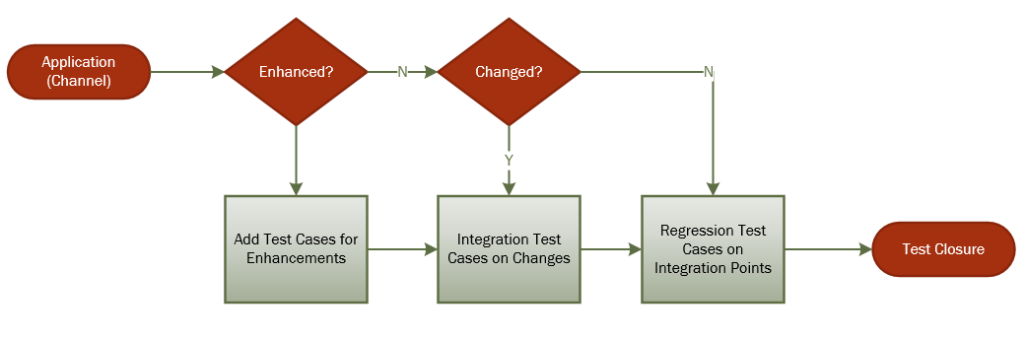
IBM WEBSPHERE MESSAGE QUEUE 8
Testing Strategy – Define Impacts & Regression

Slide 18
IBM WEBSPHERE MESSAGE QUEUE 8
Testing & Go-Live Strategy – Testing Requirement & Exit Criteria
Regression Test Cycle I
End-to-end Integration Points and/or
Impacted Integration Points and/or
Regression Test Cycle II
End-to-end Integration Points and/or
Regression Test Cycle III
And so on…
Additional Bug Fixes
And so on…
MQ New Features and/or
Application Enhancements
Impacted Integration Points and/or
Additional MQ New Features and/or
Additional Application Enhancements
Bug Fixes
Additional MQ New Features and/or
Additional Application Enhancements

Slide 19
IBM WEBSPHERE MESSAGE QUEUE 8
Testing & Go-Live Strategy – Channels Grouping in Batches
Channel Priority | Changed? | Communication Pattern | Channel Complexity (H/M/L) | Client Involvement
H | If changed or enhanced , increase its internal priority | Delivery | L | (1 to 1) Few
M |  | Request-Reply Fan-in/Fan-out | H | Moderate (1-Few/1-1*)
L |  | Publish/Subscribe | M | Many (1-*)

Slide 20
IBM WEBSPHERE MESSAGE QUEUE 8
Testing Strategy – Channels
Channel Priority | Changed? | Communication Pattern | Channel Complexity (H/M/L) | Client Involvement
H | If changed , increase its internal priority | Delivery | L | (1 to 1) Few
M |  | Request-Reply Fan-in/Fan-out | H | Moderate (1-Few/1-1*)
L |  | Publish/Subscribe | M | Many (1-*)
* More concise estimation will come out after feasibility study

Slide 21
OUR APPROACH
Our project approach will be tailored to meet Cathay Pacific’s specific objectives and operating preferences. We will leverage our extensive expertise and experience with similar initiatives, and propose to execute this initiative in six steps:
Feasibility Study
Project Initiation
Migration Planning
Migration Implementation
System Integration Test
Deployment
Step 1
Feasibility
Study
Step2
Project
Initiation
Step 3
Migration
Planning
Step 4
Migration
Implementation
Step 5
System
Integration
Test
Step 6
Deployment
Project & Change Management
Management presentation or major review points

Slide 22
Project Approach

Slide 23
PROJECT APPROACH
Step 1
Feasibility Study
Step2
Project Initiation
Step 3
Migration Planning
Step 4
Migration Implementation
Step 5
System Integration Test
Step 6
Deployment
Step 1 – Feasibility Study
PURPOSE | To Identify New Requirements/Changes on New Features (Optional) To Investigate interfaces specification of all endpoints/clients, in order to come up risk managed planning and approach To identify housekeeping processes in existing middleware To facilitate and development team to complete PoC on new version of MQ Clients Connection
KEY ACTVITIES | Work closely with middleware team to study technical documents or operation manuals of existing middleware Collect and study the interface documents of the client applications Identify the complexity and materiality level of all channels upon serving different application domains
DELIVERABLES
Feasibility Report
Impact Analysis
Dependencies of existing interfaces and MQ features
Critical Compatibility Issues
Identification of relevant systems by application owners

Slide 24
PROJECT APPROACH
Step 1
Feasibility Study
Step2
Project Initiation
Step 3
Migration Planning
Step 4
Migration Implementation
Step 5
System Integration Test
Step 6
Deployment
Step 2 – Project Initiation
PURPOSE | To study and identify technical dependency on critical business applications and infrastructure To determine current recovery time of critical business applications and infrastructure To identify relationship between critical business processes and applications and infrastructure
KEY ACTVITIES | Identify key stakeholders of all related channels Compile dependency matrix on critical IT systems
DELIVERABLES
Project Documents
Project Initiation Document
Project Plan
Project Schedule
Project Organization
Project Communication Plan
Project Communication Documents (e.g. Minutes, Status Reports)
Project Closure Report

Slide 25
PROJECT APPROACH
Step 1
Feasibility Study
Step2
System Analysis
Step 3
Migration Planning
Step 4
Migration Implementation
Step 5
System Integration Test
Step 6
Deployment
Step 3 – System Analysis and Migration Planning
PURPOSE | To Identify New Requirements/Changes on New Features (Optional) To Investigate interfaces specification of all endpoints/clients, in order to come up a less risky planning to To identify housekeeping processes in existing middleware To facilitate and development team to complete PoC on new version of MQ Clients Connection
KEY ACTVITIES | Work closely with middleware team to study technical documents or operation manuals of existing middleware Collect and study the interface documents of the client applications Provide support to application development team to conduct the PoC Document middleware architecture and configuration
DELIVERABLES
System Implementation Document
Migration Plan
System Architecture
MQ Configuration
Clusters Design
QMs, Queues, Channels
Logging, Housekeeping
HA and Disaster Recovery
Related Interfaces/Messages
Migration Phases Planning
Compatibility Issues and Consideration
Requirement Change Management
Channel/Interface Prioritization

Slide 26
PROJECT APPROACH
Step 1
Feasibility Study
Step2
System Analysis
Step 3
Migration Planning
Step 4
Migration Implementation
Step 5
System Integration Test
Step 6
Deployment
Step 4 – Migration Execution
PURPOSE | To Implement the MQ Configuration To Collect testing results on the basis of the test plan To Perform smoke test and connectivity test with dummy clients
KEY ACTVITIES | Implement the development of the WebSphere MQ and Message Broker Develop dummy endpoints to conduct System Test Develop a simple utility to perform volume test and collect testing results Extend the test cases if supplementary test is required.
DELIVERABLES
System Test Plan & Results
Performance Results

Slide 27
PROJECT APPROACH
Step 1
Feasibility Study
Step2
System Analysis
Step 3
Migration Planning
Step 4
Migration Implementation
Step 5
System Integration Test
Step 6
Deployment
Step 4 – Migration Execution
PURPOSE | To implement the new version of MQ Servers By phases to allow System Users perform the end-to-end testing with all systems involved
KEY ACTVITIES | Provide support to system user and their testing teams All related parties monitor their responsible components Monitor the stability, performance and issues of MQ Server during the testing
DELIVERABLES
SIT Test Plan and Test Result
SIT Defect Log
SIT Sign-off
Acceptance Criteria
UAT Test Plan and Test Result
UAT Defect Log
UAT Sign-off

Slide 28
PROJECT APPROACH
Step 1
Feasibility Study
Step2
System Analysis
Step 3
Migration Planning
Step 4
Migration Implementation
Step 5
System Integration Test
Step 6
Deployment
Step 6 – Middleware Deployment and Post-Production Support
PURPOSE | To ensure the deliverables quality and stability in production environment
KEY ACTVITIES | Deploy the MQ to production environment Post-deployment smoke test on all channel interfaces Monitor the end-to-end processing of the implemented interfaces
DELIVERABLES
Deployment Manual – details of the deployments steps, checks points, roll back procedures, with deployment scripts as appendix.
Deployment procedure
Deployment Steps
Detail commands
Check points
Rollback procedures

Slide 29
Proposed Team Structure

Slide 30
PROPOSED TEAM STRUCTURE
Project Assurance
Project Director
Steering Team
Project Manager
Project Delivery
Project Team
Analyst Programmer
Systems Analyst
Role | Responsibility
Project Manager | Project planning and Governance Lead to deliver the Gap Analysis Report
Systems Analyst | Conduct impact analysis and provide support to application revamp Oversee the planning and design of H/W, MQ migration & upgrade MQ Series setup and scripts and commands quality insurance, leading the testing
Analyst Programmer | Testing, Bots programming, MQ scripts and command writing
Project Director | independent and objective oversight of future performance liaison with RGP’s Global Center or Expertise when needed

Slide 31
Project Schedule

Slide 32
PROJECT SCHEDULE – Phase I
Virtualized CorpMQ Server switchover to IBM P7 machines
Propose to complete project in 14 weeks timeframe
Estimated hours for:
Project Manager 240 Hours (8 hours/day basis)
Systems Analyst 336 Hours (8 hours/day basis)
The total hours presented are ceiling hours; Consultant fee is based on Consultants’ actual billing hours that would not exceed this ceiling.

Slide 33
PROJECT SCHEDULE – Phase II
Server Re-platforming, Middleware Upgrade and End to End Testing Support
Propose to complete project in 32 weeks timeframe
Estimated hours for:
Project Manager 552 Hours (8 hours/day basis)
Systems Analyst 2784 Hours (8 hours/day basis)
Analyst Programmer 1084 Hours (8 hours/day basis)
CX will have testing team to carry out end to end testing during SIT/UAT phases, the project team will provide on-site and off-site support to CX during the testing period
The total hours presented are ceiling hours; Consultant fee is based on Consultants’ actual billing hours that would not exceed this ceiling.

Slide 34
Conclusions

Slide 35
RGP’S CAPABILITIES
Our Approach and Methodology tailored to Cathay Pacific specific needs. Our expertise lie not in implementing a single pre-determined formula, but in collaborating with Cathay Pacific to truly understand the needs and ensure we reach alignment on the identification of needs and approach for successfully meeting them together.
Unbiased Opinion. RGP is hardware and software agnostic – we are unbiased and objective when evaluating a client’s needs in relation to a system’s strength.
Change Management. Engraved as part of our overall project management capabilities, change management is a key aspect of our deliverables in which our Consultants are engaged in on-going stakeholder communication, help design and execute training and communication plans, and enable changes to be sustainable within the organization.
RGP Consultants and Client Service Team. Our Information Management practice is comprised primarily of IT and business professionals that have both technical and functional skills. Our CX Client Service representative remains committed throughout the engagement at no additional cost.

Slide 36
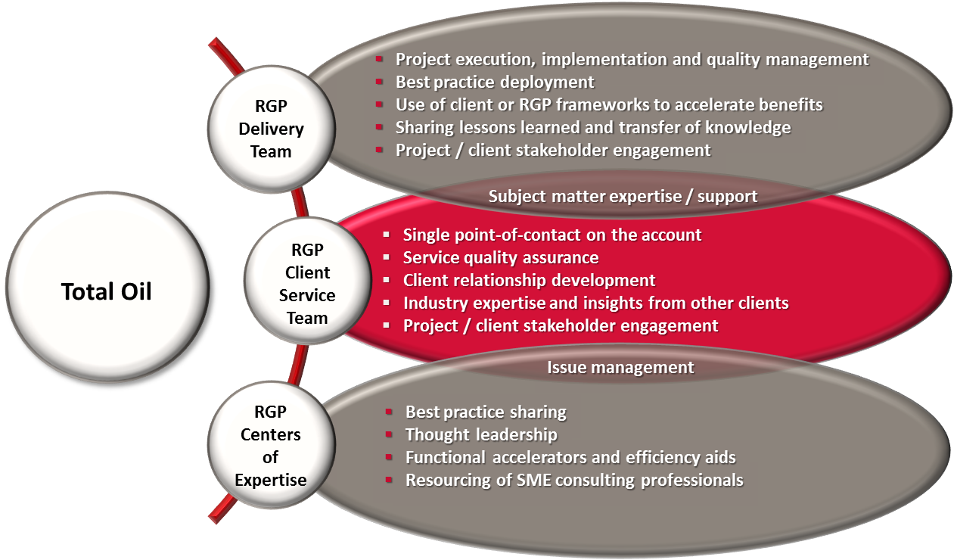
ENGAGEMENT MANAGEMENT OVERVIEW
All CX engagements will be executed under the management and support of a dedicated Engagement Team. The RGP Engagement Team is comprised of our Client Service Team and our Delivery Team, supported by our Centers of Expertise.
CX

Slide 37


CLIENT SERVICE TEAM
AARON LEE – DIRECTOR INFORMATION MANAGEMENT, HONG KONG
Hong Kong
Aaron has more than 18 years of experience in IT, specializing in managing consulting services and enterprise system solutions implementation. He came to RGP from Atos Hong Kong where he was most recently the General Manager of Consulting and System Integration, after heading up Atos' Technical Consulting for a couple of years. Before Atos, Aaron ran consulting services for Fusion System, served as Technology Specialist Lead at Microsoft Hong Kong, and served as a Senior Consultant at Sybase. Aaron holds a Bachelor's degree with Honors in Information Systems from Staffordshire University (UK). Aaron's domain expertise includes business process re-engineering, IT strategic planning and enterprise solution implementation. He is also a pioneer in exploring e-business and e-government solutions, fostering strategic alliances with technology vendors throughout Asia Pacific. Aaron will be the central point of contact and service for CX, responsible for monitoring the progress of the project and Consultant performance.
ELAINE CHEUNG – DIRECTOR FINANCE & ACCOUNTING / RISK & COMPLIANCES
Hong Kong
Elaine is a qualified accountant with professional and commercial experience in both Hong Kong and Australia. She came to RGP from Ernst & Young where she spent almost 5 years in her last position as Senior Manager in Transactions Advisory Services, responsible for insolvency, restructuring, forensic investigation and corporate finance initiatives. Prior to E&Y, Elaine had worked for several professional and corporate advisory services firms on a variety of analytical reviews on financial statements, strategic diagnostic reviews, insolvent administrations, forensic investigations and corporate restructuring. Elaine holds a Bachelor degree in Economics (majoring in Accounting & Economics) from the University of New South Wales, Australia. She is also a qualified CPA, Insolvency Practitioner in Australia and is a holder of Specialist Designation in Restructuring & Insolvency.

Slide 38

CLIENT SERVICE TEAM
SIMON KONG – MANAGING DIRECTOR, HONG KONG
Hong Kong
Simon has over 18 years of Information Management experience across industries and has led multiple consulting projects on business process transformation, shared service / BPO assessment and transition, and ERP systems implementation for RGP's clients since he joined the company in 2007. Prior to joining RGP, Simon was a Managed Services Account Executive with Computer Sciences Corporation (CSC) where he was responsible for managing regional accounts including client relationship and P&L, and leading a team of Project Managers and IT professionals to deliver professional services for global clients. Prior to CSC, Simon held a number of IT management positions at Sun Microsystems Inc. where he ran various global and regional projects on process improvement, organization transformation, and business solution implementation both within IT and across business units.

Slide 39
Q & A

Slide 40
THANK YOU
Aaron Lee
Director, Information Management Hong Kong
aaron.lee@rgp.com
+ 852 2248 2299
Resources Global Professionals
www.rgp.com
Hong Kong
Unit 2001, Ruttonjee House, 3011 Duddell Street, Central, HK
Shanghai
Room 2705-06, Lippo Plaza, 222 Huaihai Middle Road,
Shanghai 200021 PRC.
Beijing
Unit 815A, Tower1, Sun Dong An Plaza, 138 Wangfujing Dajie, Dongcheng District, Beijing 100006 PRC.
Singapore
8 Shenton Way #46-02, Singapore 068811

Slide 41
Appendix A – Requested Items for Impact Analysis

Slide 42
APPENDIX A – IMPACT ANALYSIS ITEMS
Request Items for Impact Analysis
MQ/Queue Manages Instances information
Overall Architecture diagrams, including resilience, clusters, disaster recovery
Detailed Architecture Diagrams, HA, Clusters, Remote Queue Managers (e.g.2x2 QMs topology)
Queues, especially local queues, remote queues and alias queues
*exported mqsc command is preferable.
Critical Types of Integration points in existing applications (MQI, MQ Clients, Java/JMS Client, SSL/TLS, etc.)
Statistic usage on critical types of Channel usage (e.g. Public/Subscribe, CCDT CLTCONN, Request-Reply, Fan-in/Fan-out)

Slide 43
Appendix B – RGP’s Project & Change Management Framework

Slide 44
RGP’s Project Execution Framework: ARROwS
RGP’s ARROwS Project Management Framework illustrates our project philosophy. First and foremost, RGP’s Delivery Team will follow CX’s chosen standards and methodology.
discovery
deployment
ONGOING
assess
rationalize
realize
optimize
Describe current and alternative future states | Select alternative and plan the approach | Implement approach to reach desired new state | Operate and improve the new state
Clearly understand the current state Articulate potential future states and relative values | Select a preferred alternative Define approach to realize the desired new state | Deploy solution Ensure effective and complete knowledge transfer | Incorporate feedback for continuous improvement Monitor progress
pmo in-a-box toolkit
sustain - E³ change management
Refer to the following slides for additional information regarding RGP’s Change Management framework and PMO-in-a-Box Toolkit.

Slide 45
Approach to Change Management – E3
RGP monitors all performance, execution and end products with a client-centric and agile approach which encapsulates the entire project lifecycle. RGP’s E³ Change Management framework promotes continuous improvement as best practices are identified and strategic objectives are refined.
E
Engage
Ongoing Stakeholder communication to gain and maintain buy-in and support
3
Execute
Training and communication to ensure successful implementation of change
Identify stakeholders
Develop key messages
Define engagement plan
Develop communication
Assess stakeholder impacts
Develop and deliver training
Develop and roll out communication
Assess outcomes
Enable
Organizational analysis and modification to enable and sustain change
Clarify change objectives
Evaluate change readiness
Identify organizational modifications

Slide 46
RGP’s PMO-in-a-Box
RGP’s PMO-in-a-Box incorporates tools, templates, and best practices for processes and deliverables, as applicable, serving as an accelerator for project efforts.
PMO-IN-A-BOX TEMPLATES AND TOOLS
INITIATING | PLANNING | EXECUTING | CLOSING
Project/initiative charter Stakeholder register Stakeholder management strategy Business case Project success matrix Project stakeholder map Prioritization of deliverable/functionality based on key business objectives Requirements elicitation | Plans (scope, cost, requirements, quality, schedule, resources, improvements, progress, communication, risk and procurement) Risk assessment Project cost estimator Performance metrics inventory Project portfolio management Workflow deliverables Business readiness plan Project team roster Project organization chart RACI matrix | Project status report Project meeting agenda Project meeting notes Project issues register Project risks register Project action items register Project change request Project change requests register Risk evaluation matrix Project process health assessment Project performance measures roadmap | Project acceptance Post project review Lessons learned

